Slide 1
CONVERTOR
FINAL PROJECT
Group 4
Nguyen Nguyen Anh Song
Hoang Le

Slide 2
CONTENTS
Overview
Our opproach
Our processing
Conclusion
1
2
3
4

Slide 3

OVERVIEW
Different Countries
Different Units
Convertor

Slide 4
APPROACH
Basic of function calculation:
Function temperature: Celsius/5 = (Fahrenheit-32)/9
Function length: 1 km = 0.621371 mile
Function weight: 1 pound = 0.45359237 kg
Function pressure: 1 kPa = 12.35 Psi

Slide 5
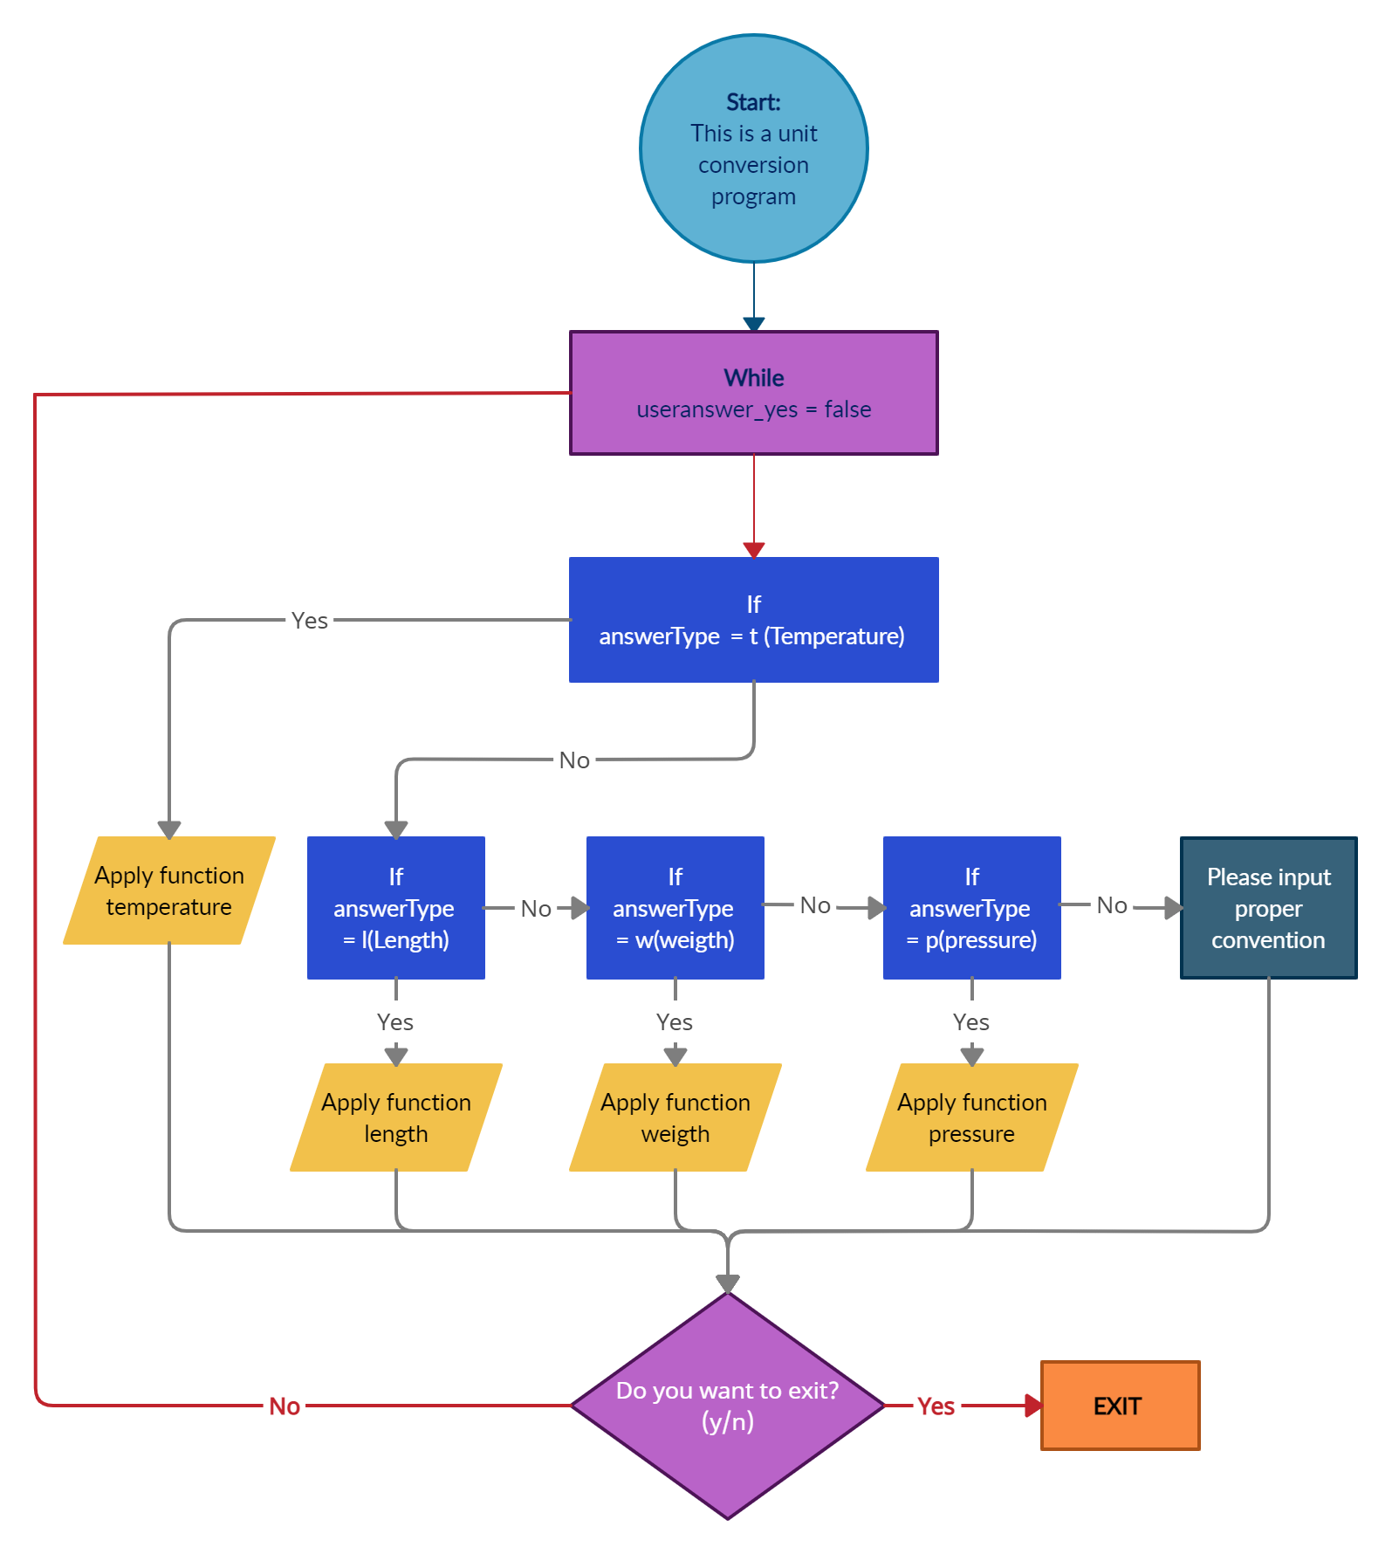
APPROACH
Flow chart:
!
Challenges:
Yes
Time limit
Unfamiliar work
No
No
No
No
Yes
Yes
Yes
No
Yes

Slide 6




PROCESSING

Slide 7
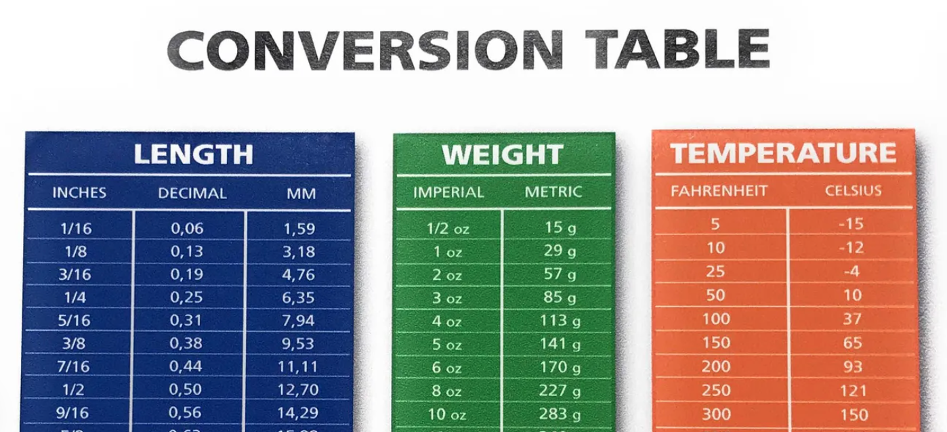
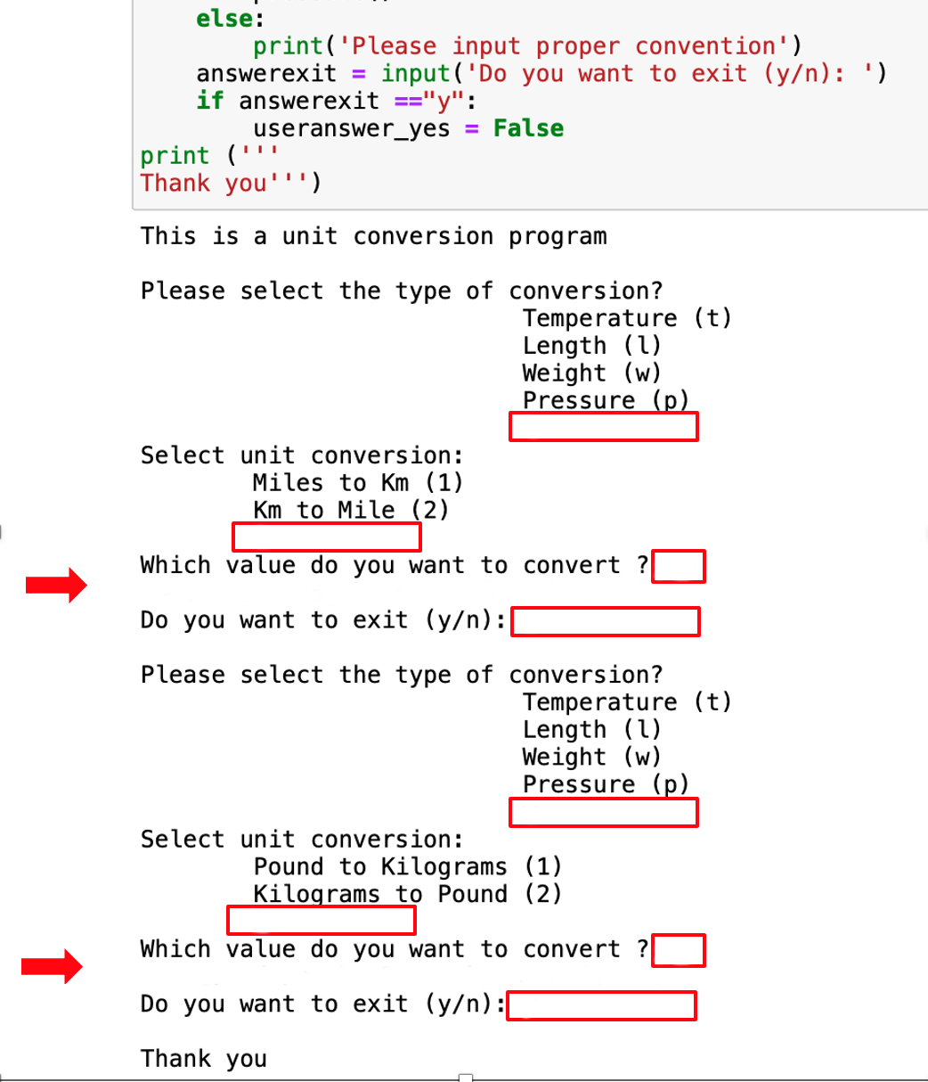




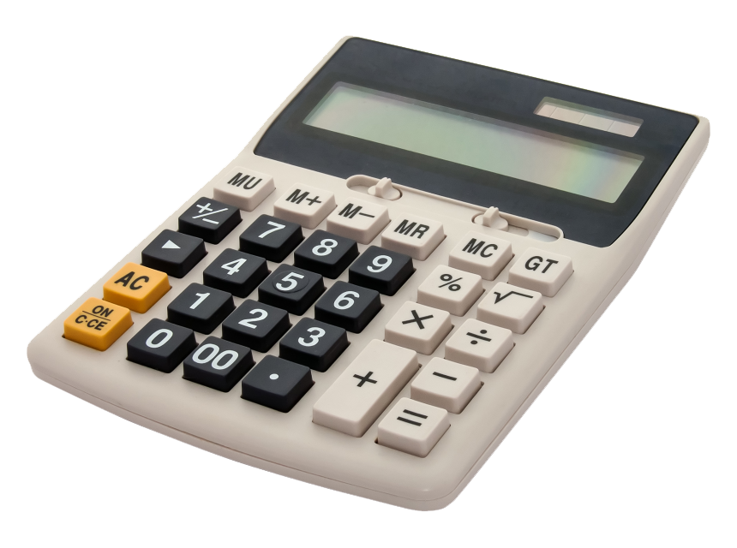





CONCLUSION

Slide 8
THANK YOU
Q&A

